Slide 1


Slide 2
Project Objective
Improve revenue and product performance
Analyze sales data
Identify top products
Understand customer behavior
• Support CEO decision-making

Slide 3
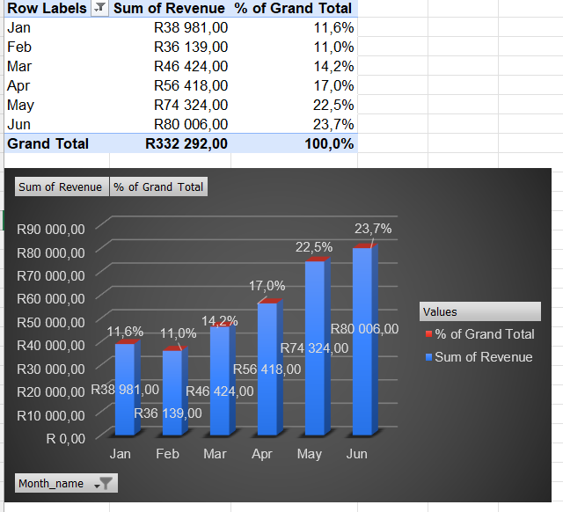
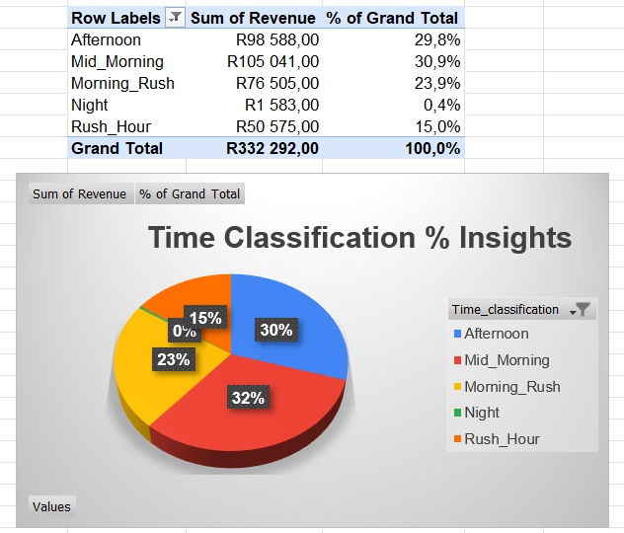
Monthly insights
Key Insight
Sales show a strong upward trend from January to June from (12% to 24%).
June is our top-performing month with 24% revenue, followed closely by May with 23% revenue.
Mid-Morning period delivered the strongest performance.

Slide 4
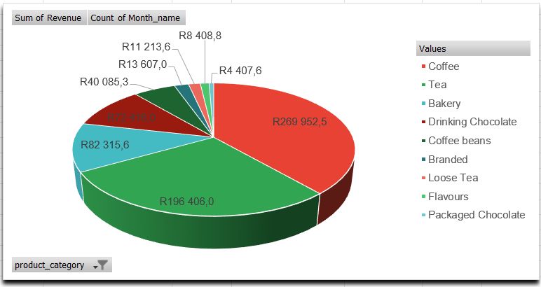
Monthly product trends
Key Insight
Coffee consistently leads all products in revenue generating 39.2% showing strong and steady growth from January to June., Tea comes behind at 30,1% revenue.
Loose tea, flavours, packaged chocolate are our bottom 3 performing products contribute a combined 3.4% of monthly revenue across all months.

Slide 5
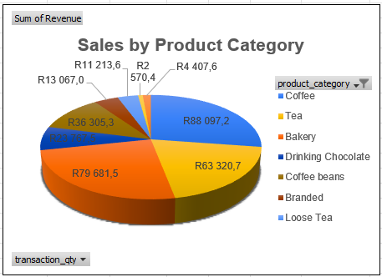
Sales by Product Category
• Coffee dominates sales
• Beverages perform consistently
• Pastries secondary
Key Insight
Sales are heavily concentrated in a few high-performing product types, with Coffee (88,097.2), Bakery (79,681.5), and Tea (63,320.7) leading total revenue. This indicates a strong customer preference for premium and specialty beverages

Slide 6
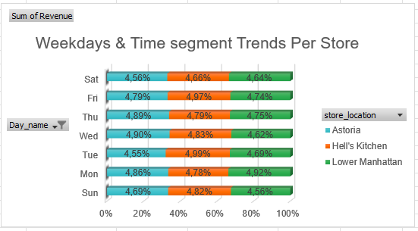
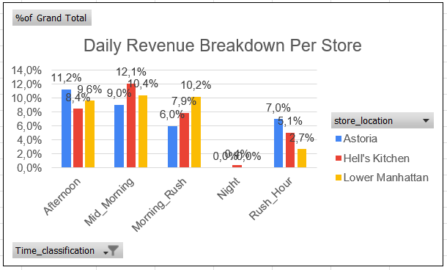
Weekdays & Time segment Trends Per Stores
Key Insight
Monday and Friday are the top performing weekdays ranged between 14.5% to 14,6% with Lower Manhattan leading on Monday (4.9%) and Hell's Kitchen leading on Friday (5.0%).
Sales are slightly lower across all stores on weekend ranged between 4.6% to 4.8% .
All Store performance peaks during the morning drive, Lower Manhattan leading at 12.01%, followed closely by Hell’s Kitchen at 00%.
Rush-Hour and Night hours across all stores, indicating inactive operating hours contributing 15%

Slide 7
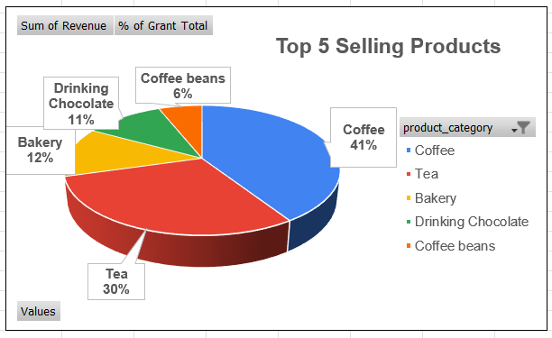
Top 5 Selling Products
Coffee
Tea
Bakey
Drinking Chocolate
Coffee beans
Key Insight
Sales are heavily driven by coffee and tea, contributing over 70% of revenue. While this shows strong performance in core products, it also highlights an opportunity to grow our secondary categories through targeted promotions and bundling strategies.

Slide 8
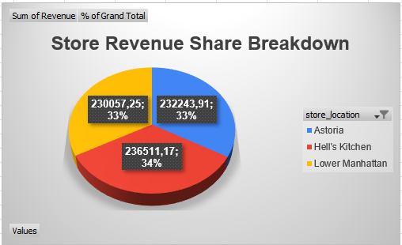
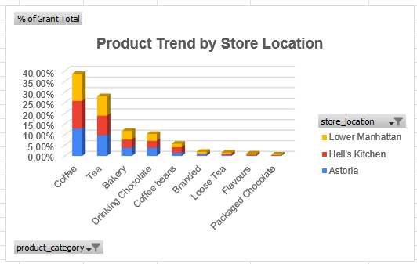
Store LOCATION TRENDS
Key Insight
Hell's Kitchen leads in total revenue makes it our top store holding 34%, followed by Astoria at 33% total revenue.
Coffee is the top-seller in all locations, Hell’s Kitchen leads in coffee revenue contributing 13.1%, Astoria follows closely with 12.8% revenue.
Tea ranks second, making up 28.1% of total sales, Astoria leads in tea revenue contributing 9.7% .
Loose Tea, Flavours, and Packaged Chocolate have low sales, contributing just 3.4% of total sales across all store.

Slide 9
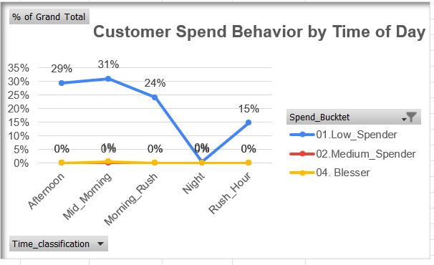
Peak Sales Time Analysis
Key Insights
Sales are heavily concentrated in Mid-Morning and driven by Low Spenders
Mid-Morning contributes the highest share (31%)
Afternoon (29%) and Morning Rush (24%) follow closely
Low Spenders dominate nearly 100% of sales activity
Night shows zero engagement across all segments

Slide 10

Recommendations
☕.Product Optimization
Increase stock levels of top-performing products to avoid stockouts during peak hours
Position these items prominently (menu boards, counter displays)
Create premium versions or upsells (e.g., larger sizes, add-ons like extra shots or flavors
Most coffee shops generate a large share of revenue from a small number of products — scaling these gives the fastest return
. Fix Underperforming Products: Low-performing items are costing space and attention
Identify bottom 20% products by revenue Improve them (better pricing, bundling, visibility), OR Remove them completely from the menu OR,
Alternately Bundle weak products with best-sellers (e.g., pastry + coffee combo)
Maximize Peak Hour Revenue: The busiest times are the biggest opportunity.
Increase staffing during peak hours to reduce waiting time
Introduce fast-service options (pre-made items, express line)
Push high-margin items during these hours
👉Turn dead hours into revenue-generating periods instead of wasted capacity
By: Run time-based promotions (Like Happy Hour” discounts, Buy 1 Get 1 Free)
⚙. Improve Operational Efficiency: Revenue isn’t just about sales — it’s also about speed
Reduce preparation time for popular items
Standardize processes during busy hours
Train staff based on peak-time demand patterns

Slide 11
Conclusion
This analysis demonstrates that adopting a data-driven approach is essential for improving overall business performance at Bright Coffee Shop. By focusing on peak trading hours and prioritizing top-performing products, the company can maximize revenue and operational efficiency.
However, sustained success will depend on continuous monitoring of sales patterns and product performance, enabling the business to adapt quickly to changing customer behavior and maintain long-term growth.

Slide 12
Thank You By Tendai SHUMBA
Questions & Discussion

